Slide 1
MODULE 2: BASELINE ASSESSMENT
Session 12: Coping Strategies
Notes:
Coping Strategies

Slide 2
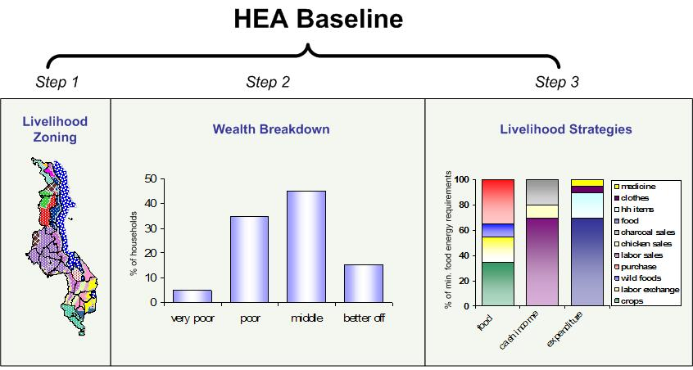
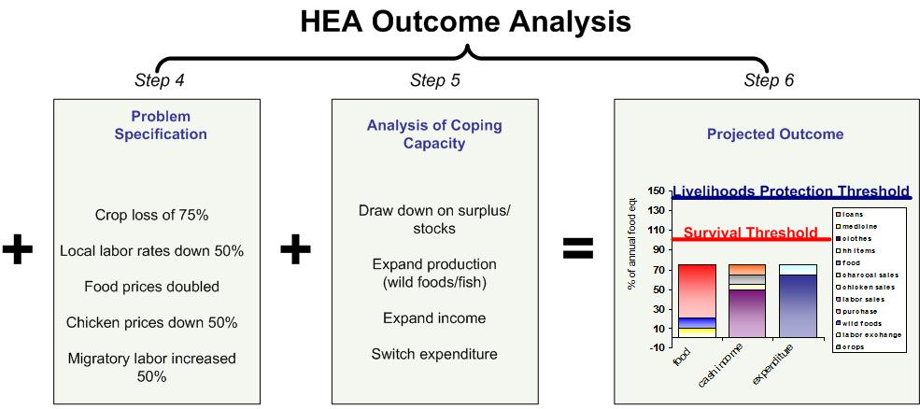
Where do Coping Strategies fit?
The analysis of coping capacity is Step 5 in the Framework. It is necessary to conduct this analysis before carrying out the projected outcome analysis.
Session 12: Coping Strategies

Slide 3
What are Coping Strategies?
Coping strategies are the things that households do to try to increase their food and cash income after a shock or hazard
Session 12: Coping Strategies

Slide 4
Some Typical Coping Strategies
Examples include:
Increasing livestock sales
Collecting more wild foods
Sending more household members to work in town or in the fields of richer households
Session 12: Coping Strategies

Slide 5
Why are Coping Strategies Important in HEA?
Analysing coping strategies
determines how much of a gap is left to be filled by external assistance, and
provides monitoring guidance to test and revise a predicted outcome
Session 12: Coping Strategies

Slide 6
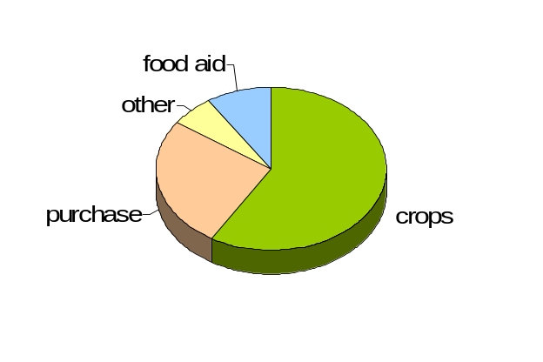
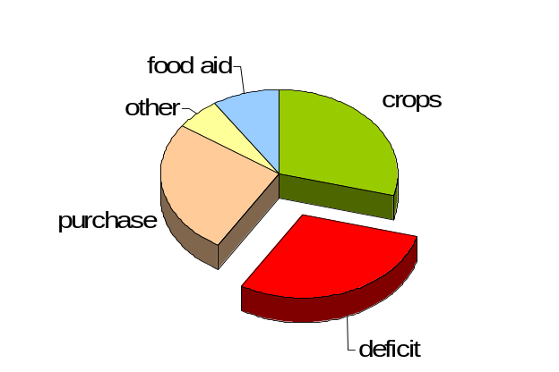
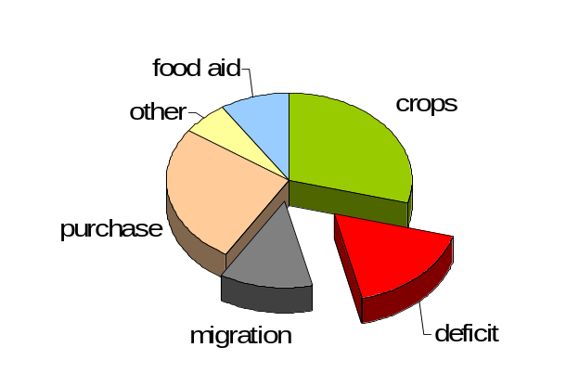
Why are Coping Strategies Important in HEA?
Analysing coping strategies determines how much of a gap is left to be filled by external assistance
Coping step example:
1 household member migrates for labour
Hazard example:
50% crop failure
The baseline picture
Effect on access to crops
Final result
Session 12: Coping Strategies

Slide 7
Why are Coping Strategies Important in HEA?
Provides monitoring guidance to test and revise a predicted outcome
Are people migrating?
What is happening to daily wages?
What is happening to food prices?
Coping step example:
1 household member migrates for labour
Final result
Session 12: Coping Strategies

Slide 8
How are Coping Strategies Analysed in HEA?
STOP
Each coping strategy has a cost attached to it
High cost strategies are discussed in the text of a report, but left out of the projected outcome analysis
Why?
Session 12: Coping Strategies

Slide 9
How are Coping Strategies Analysed in HEA?
Because HEA does not model household behaviour
It helps identify appropriate points of intervention
Session 12: Coping Strategies

Slide 10
How are Coping Strategies Analysed in HEA?
By leaving a coping strategy out of the projected outcome analysis, we are saying that an intervention should occur before households have to revert to that option (e.g. prostitution, reduced consumption, child labour, etc.)
Session 12: Coping Strategies

Slide 11
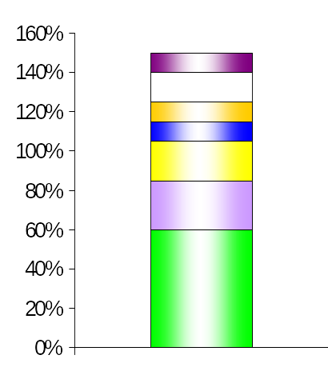
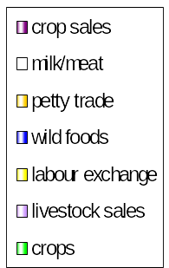
How are Coping Strategies Analysed in HEA?
For example, if this is the baseline picture
Livelihood Protection Threshold
Survival Threshold
Session 12: Coping Strategies

Slide 12
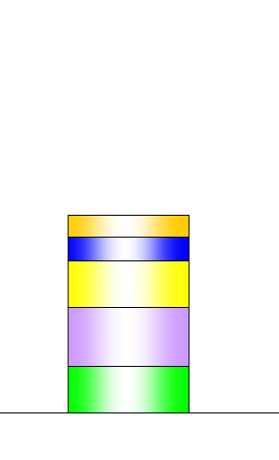
How are Coping Strategies Analysed in HEA?
And this was the initial result of a shock…
Livelihood Protection Threshold
Survival Threshold
Session 12: Coping Strategies

Slide 13
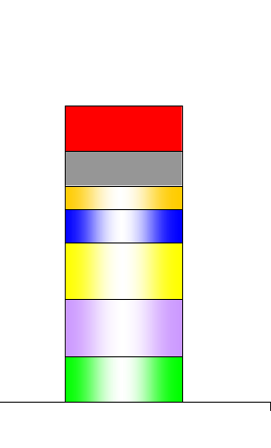
How are Coping Strategies Analysed in HEA?
You would want an intervention to occur before households needed to revert to the last two coping strategies
Livelihood Protection Threshold
Survival Threshold
Prostitution
Child labour
Session 12: Coping Strategies

Slide 14
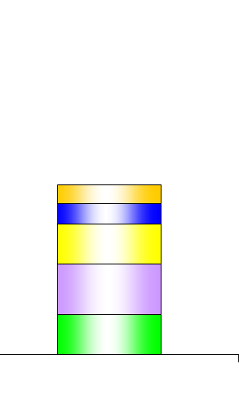
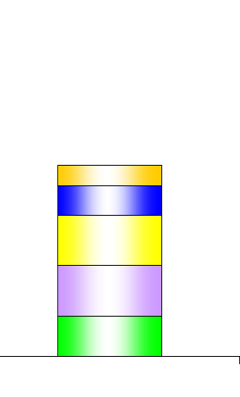
How are Coping Strategies Analysed in HEA?
So you would leave them out of the projected outcome analysis to show the gap without their inclusion.
Livelihood Protection Threshold
Survival Threshold
Gap
Session 12: Coping Strategies

Slide 15
Coping Strategies: Cost Categories
Reduced expenditure on non-essential items
Low Cost
Harvesting of reserve crops (e.g. cassava, enset)
Session 12: Coping Strategies
Notes:
Non essentials include: (beer, cigarettes, ceremonies, festivals, expensive clothing, meat, sugar, more expensive staples, etc.)
Coping Strategies

Slide 16
Coping Strategies: Cost Categories
Increased sale/slaughter of livestock (at sustainable levels to maintain herd viability)
Intensification of local labour activities
Short-term/seasonal labour migration
Intensification of self-employment activities (firewood, charcoal, building poles, etc.)
Increased remittance income
Increased social support/gifts
Borrowing of food/cash
Sale of non-productive assets (jewellery, clothing, etc.)
Medium Cost
Session 12: Coping Strategies
Notes:
Non essentials include: (beer, cigarettes, ceremonies, festivals, expensive clothing, meat, sugar, more expensive staples, etc.)
Coping Strategies

Slide 17
Coping Strategies: Cost Categories
Unsustainable sale/slaughter of livestock
Long-term/permanent migration (including distress migration of whole households)
Excessive sale of firewood/charcoal (e.g. because of its effect on the environment)
Sale/mortgaging of productive assets (land, tools, seeds, etc.)
Prostitution
Reduced expenditure on productive inputs (fertilizer, livestock drugs etc.)
Reduced expenditure on health and education
Reduced expenditure on water
Decreased food intake
High Cost
Left out of HEA Projected Outcome Analysis
Session 12: Coping Strategies
Notes:
Non essentials include: (beer, cigarettes, ceremonies, festivals, expensive clothing, meat, sugar, more expensive staples, etc.)
Coping Strategies

